Slide 1
Renewable Power in California
Challenges and Opportunities in the Electricity Market
Tim Tutt
Manager (Acting)
Renewable Energy Program

Slide 2
Here’s The Story
Background
Crisis
Aftermath
Future

Slide 3
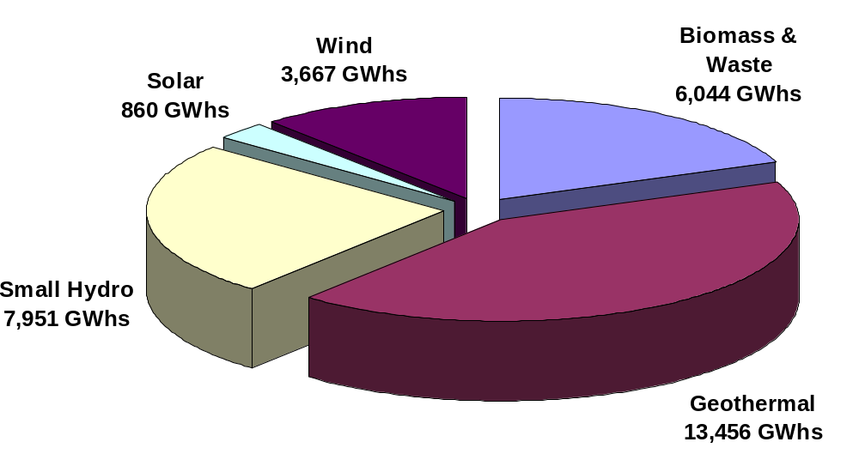
California’s Renewable Energy
(31979 GWh in 2000)

Slide 4
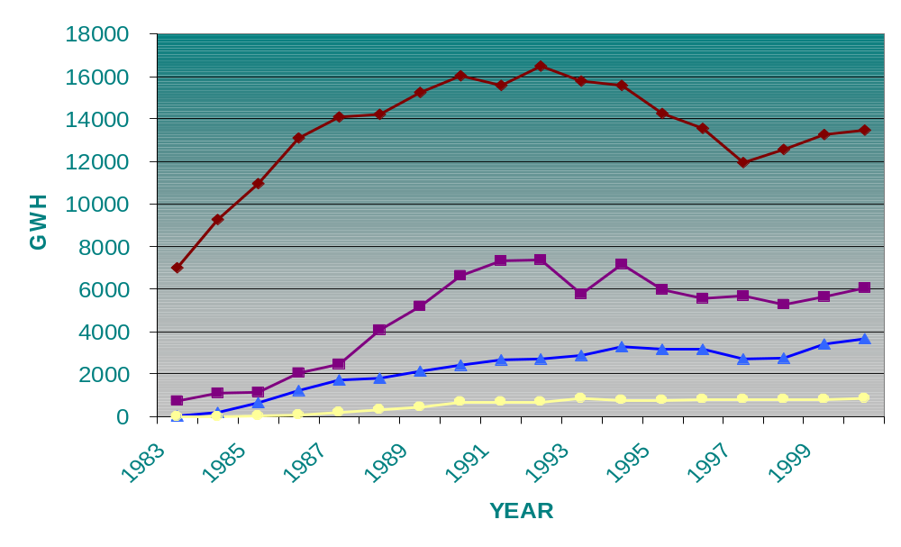
Renewable GWh By Type
REP
Era
Standard Offer Era
Uncertainty Era
GEOTHERMAL
BIOMASS
WIND
SOLAR
Notes:
California has developed one of the largest and most diverse renewable energy generation industries in the world over the last 2 decades, with over 7,000 MW of renewable energy capacity in 2000.
Renewable energy development in the state arose from the Public Utility Regulatory Policies Act of 1978, requiring utilities to purchase power from non-utility generators at the utilities’ full avoided cost.
California implemented this federal law through ‘standard offer’ contracts. Most of the non-utility contracts with renewable generators provided fixed-rate payments for 10 years, based on forecasted costs. About 5,000 MW of renewable capacity was added to California’s electricity system between 1985 and 1990.
Renewable electricity generation declined from 1990 to 1998 when high fixed-price contracts were ending and current energy prices were low.
The Renewable Energy Program was established to provide support to reduce or reverse the declining trend in California’s renewable electricity generation, especially in the face of electric industry restructuring, where public purpose needs are not adequately met in a competitive market.
1999 and 2000 record wind generation in CA
Geothermal turnaround with wastewater injection, new plants
130 MW of biomass restarts this spring

Slide 5
Renewable Energy Program
AB 1890, passed in September 1996, allocated $540 million; ordered CEC Policy Report
SB 90, passed in November 1997, detailed funds as Support for:
  Existing Power Plants
  Development of New Power Plants
  Emerging Renewable Technologies Such as Solar Photovoltaics
  Consumer Purchases of Renewable Power
  Consumer Education About Renewables
Program Started in 1998

Slide 6
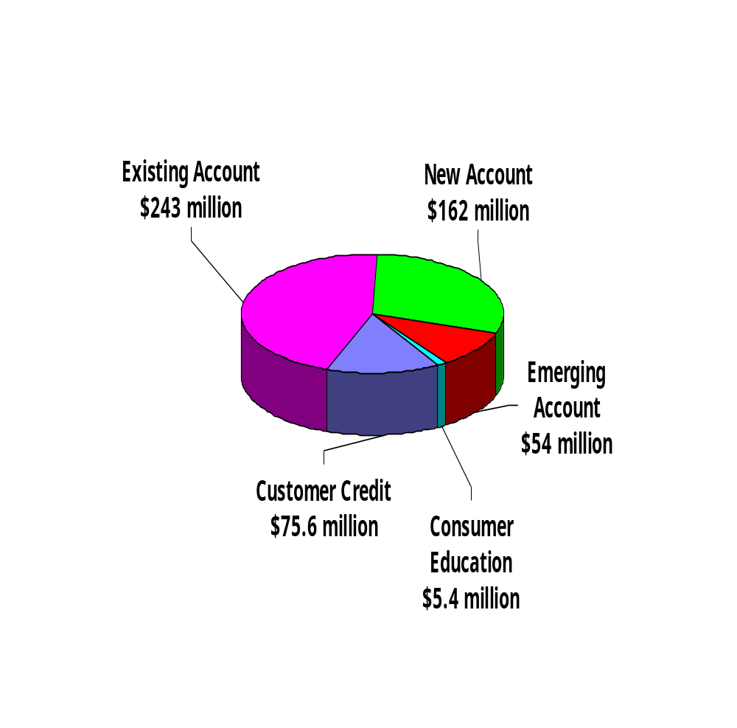
REP: Operating Principles
Ties to Market Prices and Activity
Pay For Performance
Address Demand as well as Supply
Flexibility To Change With Market
Minimize Administrative Costs
Target Funds Where Needed

Slide 7
Story - Continued
Background
Crisis
Aftermath
Future

Slide 8
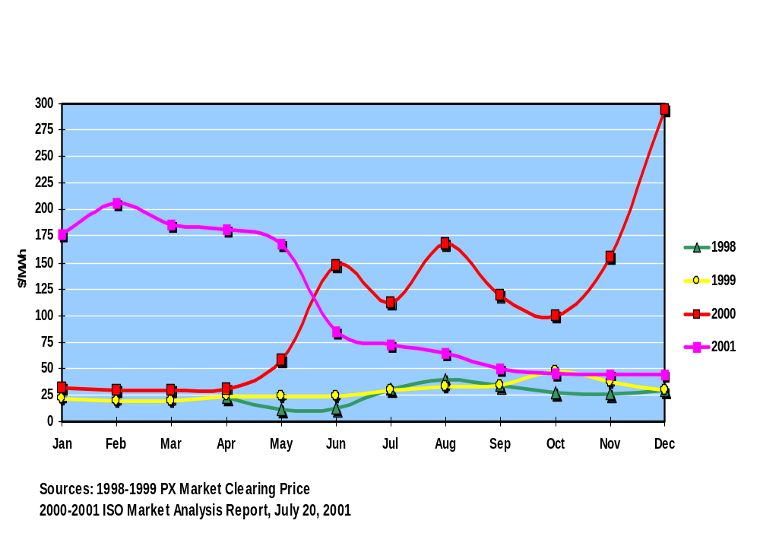
California Electricity Prices
Notes:
June was first month in 2 years where average wholesale prices are lower than same month year ago.
Average wholesale prices for last 3-4 months are at pre-crisis levels.

Slide 9
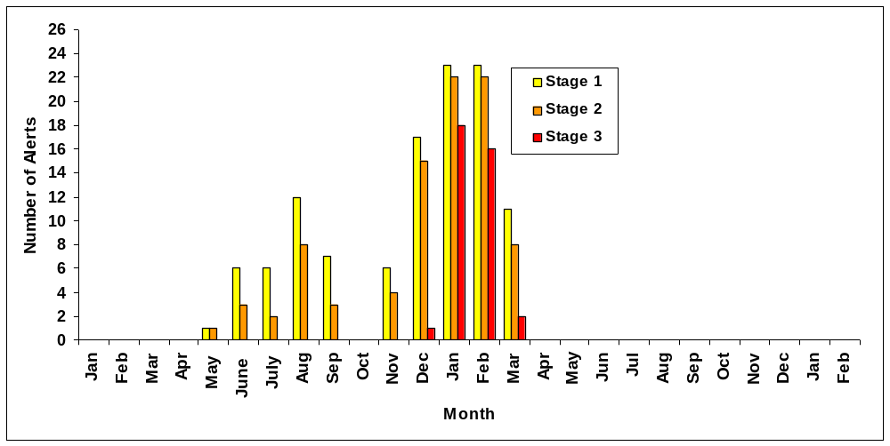
ISO Declared Emergencies - 1/00 to 2/02
Notes:
1998 1999 2000 2001
No Touch 8 12 77 166
Alert 7 2 34 180
Warning 8 6 85 180
Power Watch N/A N/A 20 26
Stage 1 7 4 55 70
Stage 2 5 1 36 65
Stage 3 0 0 1 38

Slide 10
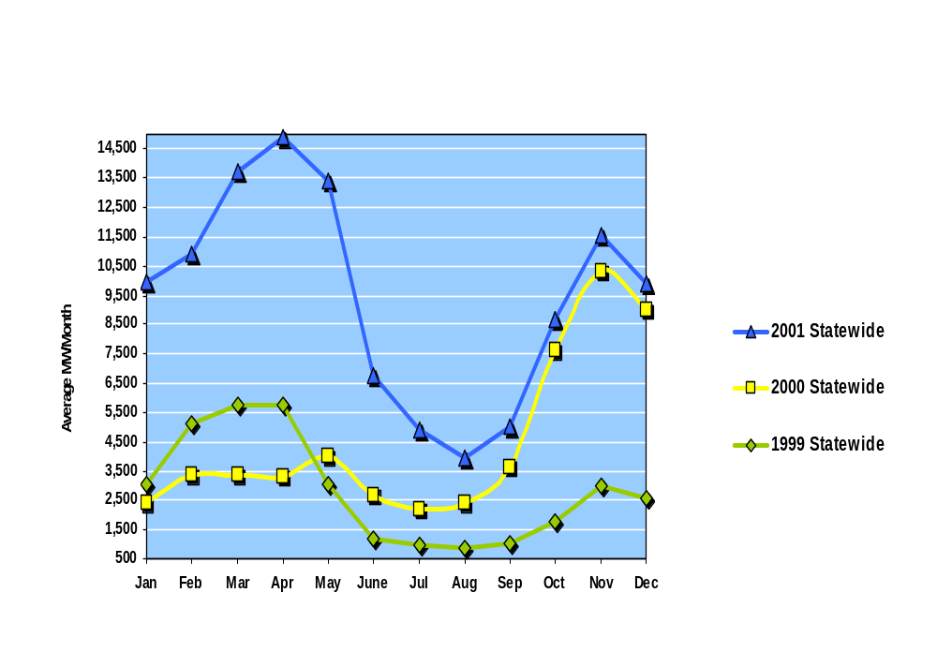
Historical Generation Outages
Scheduled and Forced
(Average MW/Month)
Outages 2-4x greater in Fall/Winter/Spring 2000-01
Notes:
Here we can see just how dramatic the level of outages were. Outages both planned and unplanned ran 2 to 4x higher than previous year.
Outage data based on ISO #s. Does not reflect an estimated 2-3,000 MW QF capacity that went off-line in the spring because of non-payment from the IOUs. Gas suppliers who hadn’t been paid refused to sell gas to QFs (cogeneration projects) as well well as merchant generators.

Slide 11
Renewables in the Crisis
130 MW of Biomass came back on-line
200 MW of New Renewable powerplants on-line
Wind generation came on just in time on at least 2 occasions
Existing Renewables continued to generate during financial crisis

Slide 12
Story - Continued
Background
Crisis
Aftermath
Future

Slide 13
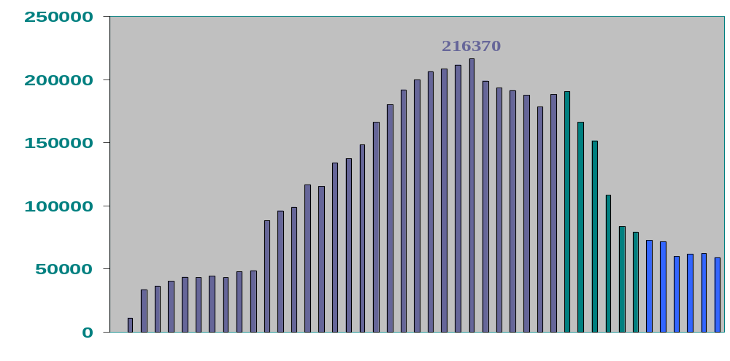
Green Market:
Customer Credit Account
May 2000
Dec., 2000
April, 1998
1998
1999
2000
2001
Notes:
19 active providers in last half of 2000, 9 only by April 2001, now down to 3
renewable percentage of direct access customers grew to 90% or more by mid-1999; DA market in CA unprofitable without credit

Slide 14
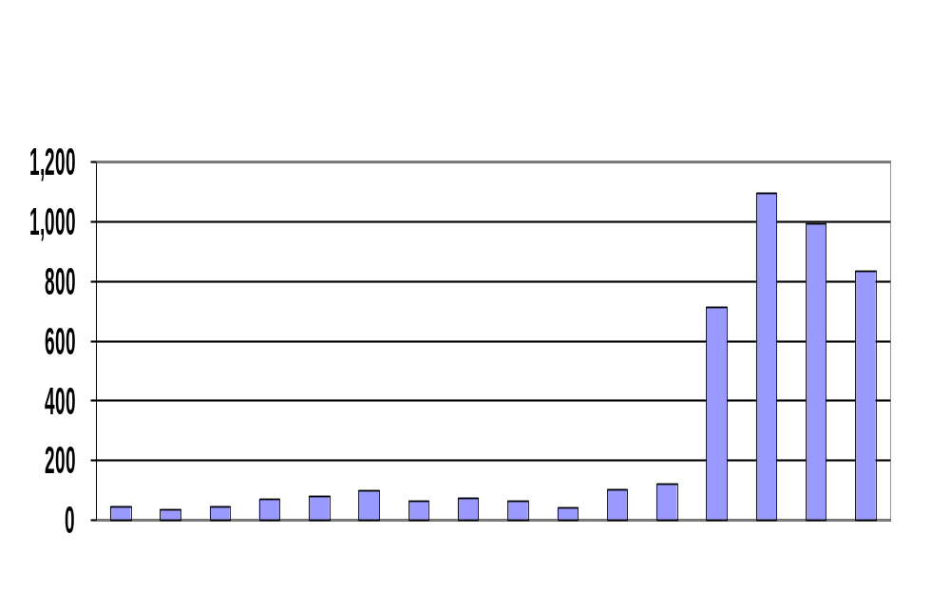
Buydown Activity:
Quarterly Reservations
1998
1999
2000
2001
Notes:
Governor requests that rebates increase in February
CEC and new CPUC program respond by May
Prior to 1998, grid-connected installations averaged less than 1 per month.

Slide 15
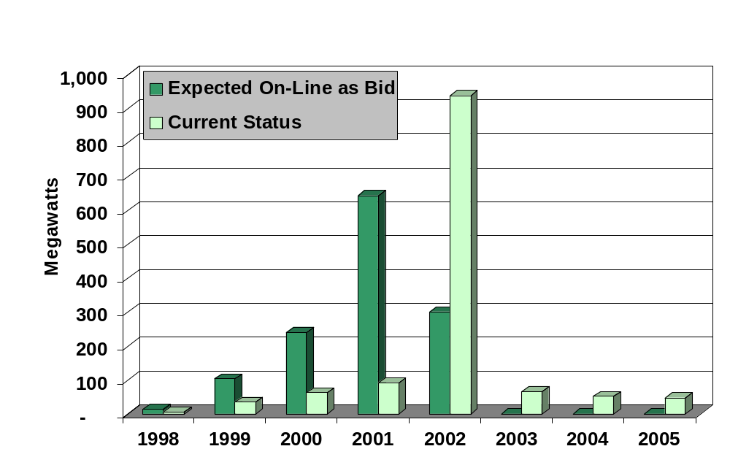
New Account:
On-Line By Year
Notes:
180 MW operational today, 70 MW wind, 60 MW geothermal, 30 MW LFG
Most of remaining capacity is wind
Have had difficulty with power purchase contracts during the crisis

Slide 16
Existing Renewables
Most Now or Soon-to-be Covered by Fixed-Price 5-year Contracts at 5.37 cents/kWh plus capacity payments
Exceptions:
  Facilities that had moved to competitive market, no longer under Standard Offer contracts
  Biomass Facilities that returned to service in 2001
These facilities will probably receive similar deals

Slide 17
Story - Continued
Background
Crisis
Aftermath
Future

Slide 18
INVESTMENT PLAN
Where We Are Going
GOAL: Pursue investments in renewable resources to achieve self-sustaining renewable energy supply.
Investment Plan recommends allocation and distribution of $675 million collected 2002 - 2006
“Investing in Renewable Electricity Generation in California”
Plan establishes numerical targets for ramping up percentage of California’s electricity generation from renewables
  12% in 2002 17% by 2006
Plan contains built-in flexibility to respond to market changes
GOAL
Notes:
The Energy Commission’s goal is to vigorously pursue investments in renewable resources with the long-term view of a fully competitive and self-sustaining renewable energy supply in California.
The Commission developed an Investment Plan for recommending allocation of public goods funds for renewables for 2002-2006.
The Commission adopted targets for renewable energy consumption in the state, beginning with the current baseline of 12 percent of California’s total. The target percentage is an annual increase of one percent point per year, reaching 17 percent of generation for use in California by 2006.
The Plan contains built-in flexibility so that the program can be modified as needed to respond to market changes.
Pending legislative approval, SB 532 would authorize the Commission to implement the Investment Plan.

Slide 19
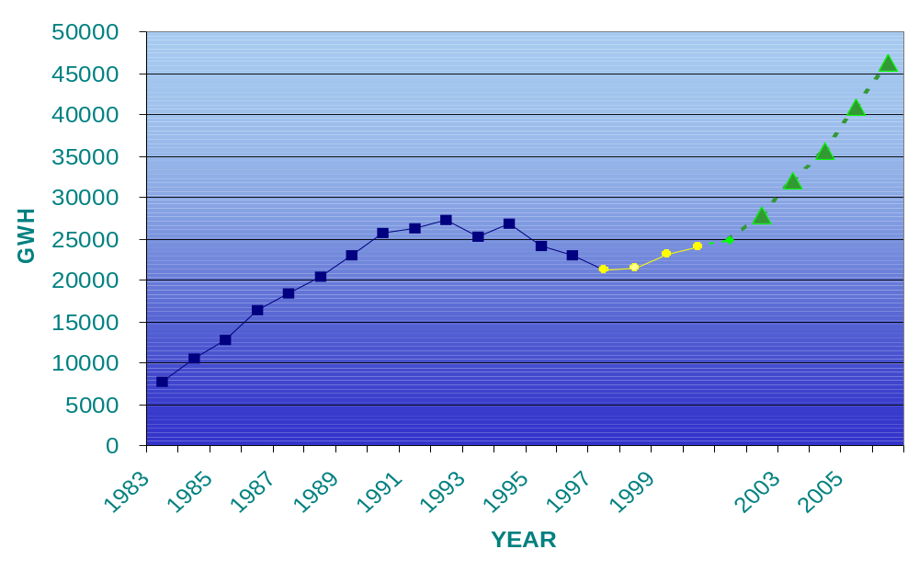
INVESTMENT PLAN
Renewables Generation Goals
Renewable Energy Program
GOALS
Notes:
Electricity generated from renewable energy sources enjoyed a rising trend in the 1980’s and early 1990’s. By the mid-90’s renewable energy generators were faced with a ‘price-cliff’ situation created when they moved from the high fixed-prices for energy to the variable energy price periods of their long-term contracts. Energy prices were much lower than forecasts predicted. Energy payments would sharply decline and renewables generation would continue to decrease.
The Renewable Energy Program began operation in 1998, as shown by the yellow trend line, and successfully reversed the declining trend in California’s renewable electricity generation.
The high energy prices and market fluctuations seen in 2000 and 2001 create a highly uncertain atmosphere in which developers and their financial backers might be reluctant to commit to renewable energy projects.
To provide a measure of market certainty while ensuring effective use of funds, the Renewable Energy Program’s Investment Plan recommends continuing to provide incentive programs linked to the market to reach the goals shown in green.

Slide 20
Other California Policies
CPUC Self Generation Program
California Power Authority Investment Plan
Solar/Wind Income Tax Credit
SF Solar bond Issue
Possible Renewable Portfolio Standard
Research and Development - PIER

Slide 21
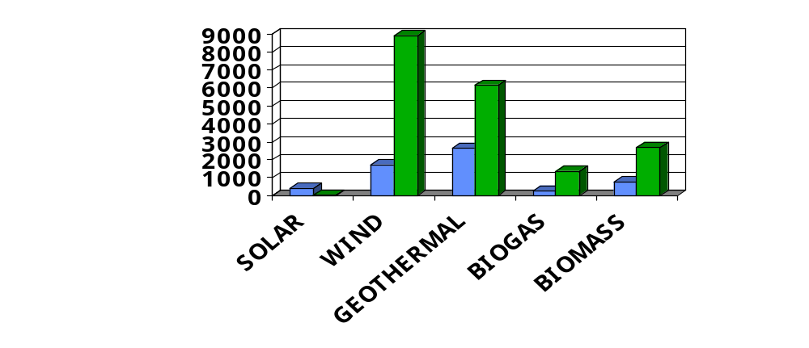
California Renewables:
Installed VS Potential
Way too much to show on a graph
MW

Slide 22
Down the Road
Technology Improvements
  Cost Reductions
  Increased Efficiency
  Reduced Maintenance
Enhanced System Value
  Nexus Between Resource and Need
  Secondary Benefits: e.g. - Cooling Reductions
  Reactive Power ---- Electronically
  Spinning Reserve ---- Distributed PV
  Reliability --- Multiple distributed renewable systems

Slide 23
Conclusions
In the Near Term - Look for significant expansion of Renewable Supply In CA
In the Long Term - Look for significant role for renewables - particularly distributed renewables - in a quite different electricity market structure
For more information:
  Tim Tutt -- (916) 654-4590
  www.energy.ca.gov/renewables

